Slide 1
Chapter 7. Cluster Analysis
What is Cluster Analysis?
Types of Data in Cluster Analysis
A Categorization of Major Clustering Methods
Partitioning Methods
Hierarchical Methods
Density-Based Methods
Grid-Based Methods
Model-Based Methods
Clustering High-Dimensional Data
Constraint-Based Clustering
Outlier Analysis
Summary

Slide 2
What is Cluster Analysis?
Cluster: a collection of data objects
  Similar to one another within the same cluster
  Dissimilar to the objects in other clusters
Cluster analysis
  Finding similarities between data according to the characteristics found in the data and grouping similar data objects into clusters
Unsupervised learning: no predefined classes
Typical applications
  As a stand-alone tool to get insight into data distribution
  As a preprocessing step for other algorithms

Slide 3
Clustering: Rich Applications and Multidisciplinary Efforts
Pattern Recognition
Spatial Data Analysis
  Create thematic maps in GIS by clustering feature spaces
  Detect spatial clusters or for other spatial mining tasks
Image Processing
Economic Science (especially market research)
WWW
  Document classification
  Cluster Weblog data to discover groups of similar access patterns

Slide 4
Examples of Clustering Applications
Marketing: Help marketers discover distinct groups in their customer bases, and then use this knowledge to develop targeted marketing programs
Land use: Identification of areas of similar land use in an earth observation database
Insurance: Identifying groups of motor insurance policy holders with a high average claim cost
City-planning: Identifying groups of houses according to their house type, value, and geographical location
Earth-quake studies: Observed earth quake epicenters should be clustered along continent faults

Slide 5
Quality: What Is Good Clustering?
A good clustering method will produce high quality clusters with
  high intra-class similarity
  low inter-class similarity
The quality of a clustering result depends on both the similarity measure used by the method and its implementation
The quality of a clustering method is also measured by its ability to discover some or all of the hidden patterns

Slide 6
Requirements of Clustering in Data Mining
Scalability
Ability to deal with different types of attributes
Ability to handle dynamic data
Discovery of clusters with arbitrary shape
Minimal requirements for domain knowledge to determine input parameters
Able to deal with noise and outliers
Insensitive to order of input records
High dimensionality
Incorporation of user-specified constraints
Interpretability and usability

Slide 7
Chapter 7. Cluster Analysis
What is Cluster Analysis?
Types of Data in Cluster Analysis
A Categorization of Major Clustering Methods
Partitioning Methods
Hierarchical Methods
Density-Based Methods
Grid-Based Methods
Model-Based Methods
Clustering High-Dimensional Data
Constraint-Based Clustering
Outlier Analysis
Summary

Slide 8


Data Structures
Data matrix
  (two modes)
Dissimilarity matrix
  (one mode)

Slide 9
Type of data in clustering analysis
Interval-scaled variables
Binary variables
Nominal, ordinal, and ratio variables
Variables of mixed types

Slide 10


Interval-valued variables
Standardize data
  Calculate the mean absolute deviation:
  where
  Calculate the standardized measurement (z-score)
Using mean absolute deviation is more robust than using standard deviation

Slide 11
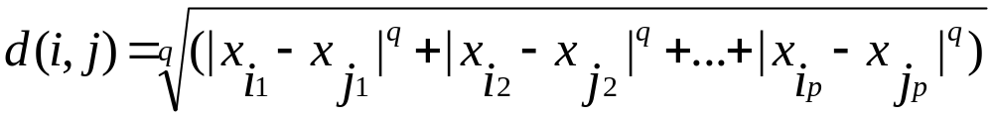

Similarity and Dissimilarity Between Objects
Distances are normally used to measure the similarity or dissimilarity between two data objects
Some popular ones include: Minkowski distance:
  where i = (x_{i1}, x_{i2}, …, x_{ip}) and j = (x_{j1}, x_{j2}, …, x_{jp}) are two p-dimensional data objects, and q is a positive integer
If q = 1, d is Manhattan distance

Slide 12
Euclidean distance andManhattan distance. Let x1 = (1, 2) and x2 = (3, 5) represent two
objects as in Figure 7.1. The Euclidean distance between the two is p

Slide 13
√(2²+3²) = 3.61.
The Manhattan distance between the two is 2+3 = 5.

Slide 14

Similarity and Dissimilarity Between Objects (Cont.)
If q = 2, d is Euclidean distance:
  Properties
    d(i,j) ≥ 0 Distance is a nonnegative number.
    d(i,i) = 0 The distance of an object to itself is 0.
    d(i,j) = d(j,i) Distance is a symmetric function.
    d(i,j) ≤ d(i,k) + d(k,j) triangular inequality
Also, one can use weighted distance, parametric Pearson product moment correlation, or other disimilarity measures

Slide 15


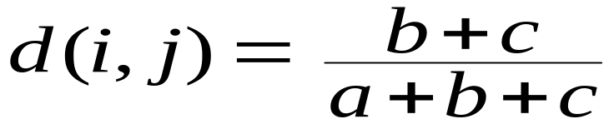
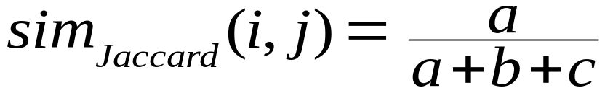
Binary Variables
Object j
A contingency table for binary data
Distance measure for symmetric binary variables:
Distance measure for asymmetric binary variables:
Jaccard coefficient (similarity measure for asymmetric binary variables):
Object i

Slide 16

Dissimilarity between Binary Variables
Example
  gender is a symmetric attribute
  the remaining attributes are asymmetric binary
  let the values Y and P be set to 1, and the value N be set to 0

Slide 17
Binary Variables
where q is the number of variables that equal 1 for both objects i and j
r is the number of variables that equal 1 for object i but that are 0 for object j
s is the number of variables that equal 0 for object i but equal 1 for object j,
t is the number of variables that equal 0 for both objects i and j.
The total number of variables is p, where
p = q+r+s+t.

Slide 18


Binary Variables
Its dissimilarity (or distance) measure, defined in Equation can be used to assess the dissimilarity between objects i and j.
The dissimilarity based on such variables is called asymmetric binary dissimilarity, where the number of negative matches, t, is considered unimportant and thus is ignored in the computation,

Slide 19


Slide 20

Nominal Variables
A generalization of the binary variable in that it can take more than 2 states, e.g., red, yellow, blue, green
Method 1: Simple matching
  m: # of matches, p: total # of variables
Method 2: use a large number of binary variables
  creating a new binary variable for each of the M nominal states

Slide 21

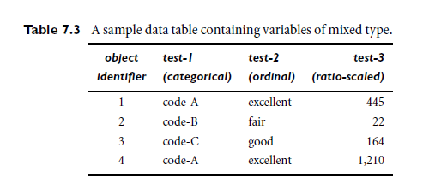
Categorical Variables

Slide 22
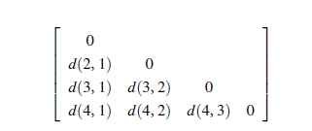
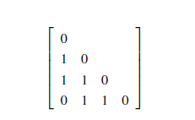
Categorical Variables

Slide 23


Ordinal Variables
An ordinal variable can be discrete or continuous
Order is important, e.g., rank
Can be treated like interval-scaled
  replace x_{if} by their rank
  map the range of each variable onto [0, 1] by replacing i-th object in the f-th variable by
  compute the dissimilarity using methods for interval-scaled variables

Slide 24
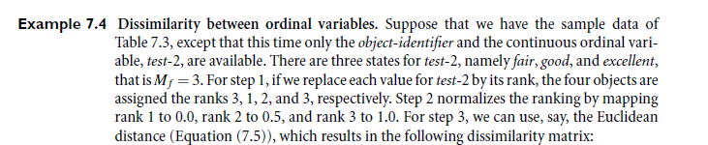
Ordinal Variables

Slide 25
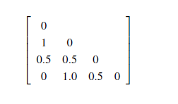
Ordinal Variables

Slide 26
Ratio-Scaled Variables
Ratio-scaled variable: a positive measurement on a nonlinear scale, approximately at exponential scale, such as Ae^{Bt} or Ae^{-Bt}
Methods:
  treat them like interval-scaled variables—not a good choice! (why?—the scale can be distorted)
  apply logarithmic transformation
y_{if} = log(x_{if})
  treat them as continuous ordinal data treat their rank as interval-scaled

Slide 27
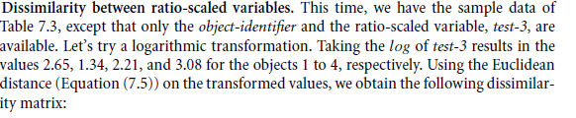
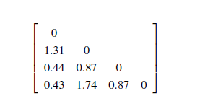
Ratio-Scaled variables

Slide 28


Variables of Mixed Types
A database may contain all the six types of variables
  symmetric binary, asymmetric binary, nominal, ordinal, interval and ratio
One may use a weighted formula to combine their effects
  f is binary or nominal:
    d_{ij}^{(f)} = 0 if x_{if} = x_{jf} , or d_{ij}^{(f)} = 1 otherwise
  f is interval-based: use the normalized distance
  f is ordinal or ratio-scaled
    compute ranks r_{if} and
    and treat z_{if} as interval-scaled

Slide 29
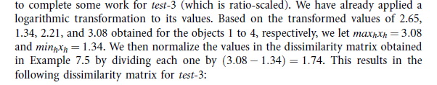

Slide 30
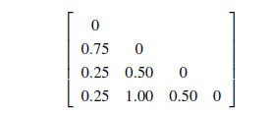

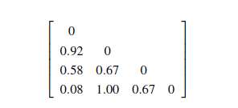

Slide 31


Vector Objects
Vector objects: keywords in documents, gene features in micro-arrays, etc.
Broad applications: information retrieval, biologic taxonomy, etc.
Cosine measure
A variant: Tanimoto coefficient

Slide 32


Slide 33
Chapter 7. Cluster Analysis
What is Cluster Analysis?
Types of Data in Cluster Analysis
A Categorization of Major Clustering Methods
Partitioning Methods
Hierarchical Methods
Density-Based Methods
Grid-Based Methods
Model-Based Methods
Clustering High-Dimensional Data
Constraint-Based Clustering
Outlier Analysis
Summary

Slide 34
Partitioning methods
Given a database of n objects or data tuples, a partitioning method constructs k partitions of the data, where each partition represents a cluster
and k ≤ n.
That is, it classifies the data into k groups, which together satisfy the following requirements:
(1) each group must contain at least one object
(2) Each object must belong to exactly one group.

Slide 35
Hierarchical methods
A hierarchical method creates a hierarchical decomposition of the given set of data objects.
A hierarchical method can be classified as being either agglomerative or divisive, based on how the hierarchical decomposition is formed.

Slide 36
Agglomerative approach
The agglomerative approach, also called the bottom-up approach, starts with each object forming a separate group.
It successively merges the objects or groups that are close to one another, until all of the groups are merged into one (the topmost level of the hierarchy), or until a termination condition holds.

Slide 37
Hierarchical methods
The divisive approach, also called the top-down approach, starts with all of the objects in the same cluster.
In each successive iteration, a cluster is split up into smaller clusters, until eventually each object is in one cluster, or until a termination condition holds.

Slide 38
Density-based methods
Most partitioning methods cluster objects based on the distance between objects.
The general idea is to continue growing the given cluster as long as the density (number of objects or data points) in the “neighborhood” exceeds some threshold;
For each data point within a given cluster, the neighborhood of a given radius has to contain at least a minimum number of points.
Such a method can be used to filter out noise (outliers) and discover clusters of arbitrary shape.

Slide 39
Density-based Clustering methods
To discover clusters with arbitrary shape, density-based clustering methods have been developed.
These typically regard clusters as dense regions of objects in the data space that are separated by regions of low density

Slide 40
DBSCAN
DBSCAN (Density-Based Spatial Clustering of Applications with Noise) is a density based clustering algorithm.
The algorithm grows regions with sufficiently high density into clusters and discovers clusters of arbitrary shape in spatial databases with noise.
It defines a cluster as a maximal set of density-connected points.

Slide 41
DBSCAN: The Algorithm
Arbitrary select a point p
Retrieve all points density-reachable from p w.r.t. € ps and MinPts.
If p is a core point, a cluster is formed.
If p is a border point, no points are density-reachable from p and DBSCAN visits the next point of the database.
Continue the process until all of the points have been processed.

Slide 42
DBSCAN
The neighborhood within a radius e of a given object is called the €-neighborhood of the object.
If the € -neighborhood of an object contains at least a minimum number, MinPts, of objects, then the object is called a core object.
Given a set of objects, D, we say that an object p is directly density-reachable from object q if p is within the €-neighborhood of q, and q is a core object.

Slide 43
Grid-based methods
Grid-based methods quantize the object space into a finite number of cells that form a grid structure.
All of the clustering operations are performed on the grid structure.
The main advantage of this approach is its fast processing time, which is typically independent of the number of data objects and dependent only on the number of cells in each dimension in the quantized space.

Slide 44
Model-based methods
Model-based methods hypothesize a model for each of the clusters and find the best fit of the data to the given model.

Slide 45
Model-based methods
EMis an algorithm that performs expectation-maximization analysis based on statistical modeling.
COBWEB is a conceptual learning algorithm that performs probability analysis and takes concepts as a model for clusters.
SOM (or self-organizing feature map) is a neural network-based algorithm that clusters by mapping high dimensional data into a 2-D or 3-D feature map, which is also useful for data visualization.

Slide 46
Model-based clustering
Model-based clustering methods attempt to optimize the fit between the given data and some mathematical model.
Such methods are often based on the assumption that the data are generated by a mixture of underlying probability distributions.

Slide 47
Expectation-Maximization
1.Make an initial guess of the parameter vector: This involves randomly selecting k objects to represent the cluster means or centers (as in k-means partitioning), as well as making guesses for the add

Slide 48

Expectation-Maximization
2. Iteratively refine the parameters (or clusters) based on the following two steps:
(a) Expectation Step: Assign each object x_{i} to cluster C_{k} with the probability
In other words, this step calculates the probability of cluster membership of object x_{i} , for each of the clusters

Slide 49

Expectation-Maximization
(b) Maximization Step: Use the probability estimates from above to re-estimate (or refine) the model parameters. For example,
This step is the “maximization” of the likelihood of the distributions given the data.

Slide 50
Constraint-based clustering
It is a clustering approach that performs clustering by incorporation of user-specified or application-oriented constraints.
A constraint expresses a user’s expectation or describes “properties” of the desired clustering results, and provides an effective means for communicating with the clustering process.

Slide 51
User-Constrained Cluster Analysis
A package delivery company with n customers would like to determine locations for k service stations so as to minimize the traveling distance between customers and service stations.
The company’s customers are regarded as either high-value customers (requiring frequent, regular services) or ordinary customers (requiring occasional services).

Slide 52
User-Constrained Cluster Analysis
The manager has stipulated two constraints: each station should serve
(1) at least 100 high-value customers and
(2) at least 5,000 ordinary customers
The general idea of clustering a large data set into k clusters satisfying user-specified constraints goes as follows.
First, we can find an initial “solution” by partitioning the data set into k groups, satisfying the user-specified constraints, such as the two constraints in our example.

Slide 53
User-Constrained Cluster Analysis
We then iteratively refine the solution by moving objects from one cluster to another, trying to satisfy the constraints.
For example, we can move a set of m customers from cluster C_{i} to C_{j} if C_{i} has at least m surplus customers (under the specified constraints).

Slide 54
Clustering high-dimensional data
It is a particularly important task in cluster analysis because many applications require the analysis of objects containing a large number of features or dimensions.
For example, text documents may contain thousands of terms or keywords as features, and DNA microarray data may provide information on the expression levels of thousands of genes under hundreds of conditions.

Slide 55
Clustering high-dimensional data
Clustering high-dimensional data is challenging due to the curse of dimensionality.
Many dimensions may not be relevant.
As the number of dimensions increases, the data become increasingly sparse so that the distance measurement between pairs of points become meaningless and the average density of points anywhere in the data is likely to below.

Slide 56
Clustering high-dimensional data
CLIQUE and PROCLUS are two influential subspace clustering methods, which search for clusters in subspaces (or subsets of dimensions) of the data, rather than over the entire data space.
Frequent pattern–based clustering, another clustering methodology, extracts distinct frequent patterns among subsets of dimensions that occur frequently.

Slide 57
Major Clustering Approaches (I)
Partitioning approach:
  Construct various partitions and then evaluate them by some criterion, e.g., minimizing the sum of square errors
  Typical methods: k-means, k-medoids, CLARANS
Hierarchical approach:
  Create a hierarchical decomposition of the set of data (or objects) using some criterion
  Typical methods: Diana, Agnes, BIRCH, ROCK, CAMELEON
Density-based approach:
  Based on connectivity and density functions
  Typical methods: DBSACN, OPTICS, DenClue

Slide 58
Major Clustering Approaches (II)
Grid-based approach:
  based on a multiple-level granularity structure
  Typical methods: STING, WaveCluster, CLIQUE
Model-based:
  A model is hypothesized for each of the clusters and tries to find the best fit of that model to each other
  Typical methods: EM, SOM, COBWEB
Frequent pattern-based:
  Based on the analysis of frequent patterns
  Typical methods: pCluster
User-guided or constraint-based:
  Clustering by considering user-specified or application-specific constraints
  Typical methods: COD (obstacles), constrained clustering

Slide 59
Typical Alternatives to Calculate the Distance between Clusters
Single link: smallest distance between an element in one cluster and an element in the other, i.e., dis(K_{i}, K_{j}) = min(t_{ip}, t_{jq})
Complete link: largest distance between an element in one cluster and an element in the other, i.e., dis(K_{i}, K_{j}) = max(t_{ip}, t_{jq})
Average: avg distance between an element in one cluster and an element in the other, i.e., dis(K_{i}, K_{j}) = avg(t_{ip}, t_{jq})
Centroid: distance between the centroids of two clusters, i.e., dis(K_{i}, K_{j}) = dis(C_{i}, C_{j})
Medoid: distance between the medoids of two clusters, i.e., dis(K_{i}, K_{j}) = dis(M_{i}, M_{j})
  Medoid: one chosen, centrally located object in the cluster

Slide 60
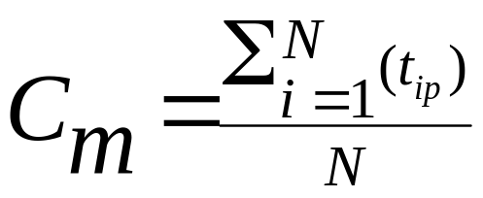
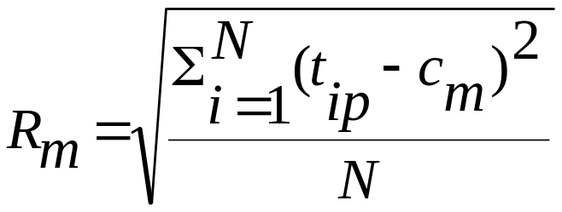

Centroid, Radius and Diameter of a Cluster (for numerical data sets)
Centroid: the “middle” of a cluster
Radius: square root of average distance from any point of the cluster to its centroid
Diameter: square root of average mean squared distance between all pairs of points in the cluster

Slide 61
k-means algorithm
The k-means algorithm proceeds as follows.
First, it randomly selects k of the objects, each of which initially represents a cluster mean or center.
For each of the remaining objects, an object is assigned to the cluster to which it is the most similar, based on the distance between the object and the cluster mean.
It then computes the new mean for each cluster. This process iterates until the criterion function converges.

Slide 62
The k-Means Method
Input:
k: the number of clusters,
D: a data set containing n objects
Output: A set of k clusters.
Method:
(1) arbitrarily choose k objects from D as the initial cluster centers;
(2) repeat
(3) (re)assign each object to the cluster to which the object is the most similar, based on the mean value of the objects in the cluster;
(4) update the cluster means, i.e., calculate the mean value of the objects for each cluster;
(5) until no change;

Slide 63
The K-Means Clustering Method
Given k, the k-means algorithm is implemented in four steps:
  Partition objects into k nonempty subsets
  Compute seed points as the centroids of the clusters of the current partition (the centroid is the center, i.e., mean point, of the cluster)
  Assign each object to the cluster with the nearest seed point
  Go back to Step 2, stop when no more new assignment

Slide 64



The K-Means Clustering Method
Example
10
10
9
9
8
8
7
7
6
6
5
5
4
Assign each objects to most similar center
Update the cluster means
4
3
3
2
2
1
1
0
0
0
1
2
3
4
5
6
7
8
9
10
0
1
2
3
4
5
6
7
8
9
10
reassign
reassign
K=2
Arbitrarily choose K object as initial cluster center
Update the cluster means

Slide 65
Comments on the K-Means Method
Strength: Relatively efficient: O(tkn), where n is # objects, k is # clusters, and t is # iterations. Normally, k, t << n.
    Comparing: PAM: O(k(n-k)² ), CLARA: O(ks² + k(n-k))
Comment: Often terminates at a local optimum. The global optimum may be found using techniques such as: deterministic annealing and genetic algorithms
Weakness
  Applicable only when mean is defined, then what about categorical data?
  Need to specify k, the number of clusters, in advance
  Unable to handle noisy data and outliers
  Not suitable to discover clusters with non-convex shapes

Slide 66
k-medoids algorithm for partitioning
Input:
k: the number of clusters,
D: a data set containing n objects.
Output:
A set of k clusters.
Method:
(1) arbitrarily choose k objects in D as the initial representative objects or seeds;
(2) repeat
(3) assign each remaining object to the cluster with the nearest representative object;
(4) randomly select a non representative object, o_{random ;}
(5) compute the total cost, S, of swapping representative object, o_{j}, with o_{random ;}
(6) if S < 0 then swap o_{j} with o_{random} to form the new set of k representative objects ;
(7) until no change;

Slide 67
OPTICS
Ordering Points to Identify the Clustering Structure
DBSCAN can cluster objects given input parameters such as € and MinPts, it still leaves the user with the responsibility of selecting parameter values that will lead to the discovery of acceptable clusters.

Slide 68
OPTICS
The core-distance of an object p is the smallest €’ value that makes {p} a core object. If p is not a core object, the core-distance of p is undefined.
The reachability-distance of an object q with respect to another object p is the greater value of the core-distance of p and the Euclidean distance between p and q.
If p is not a core object, the reachability-distance between p and q is undefined.

Slide 69
WaveCluster: Clustering UsingWavelet Transformation
WaveCluster is a multiresolution clustering algorithm that first summarizes the data by imposing a multidimensional grid structure onto the data space.
It then uses a wavelet transformation to transform the original feature space, finding dense regions in the transformed space.

Slide 70
WaveCluster: Clustering Using Wavelet Transformation
A wavelet transform is a signal processing technique that decomposes a signal into different frequency subbands.
The wavelet model can be applied to d-dimensional signals by applying a one-dimensional wavelet transform d times.
In applying a wavelet transform, data are transformed so as to preserve the relative distance between objects at different levels of resolution.

Slide 71
Advantages
It provides unsupervised clustering. It uses hat-shaped filters that emphasize regions where the points cluster, while suppressing weaker information outside of the cluster boundaries.
The multi resolution property of wavelet transformations can help detect clusters at varying levels of accuracy.
Wavelet-based clustering is very fast, with a computational complexity of O(n), where n is the number of objects in the database.
The algorithm implementation can be made parallel.

Slide 72
STING: STatistical INformation Grid
STING is a grid-based multiresolution clustering technique in which the spatial area is divided into rectangular cells.
There are usually several levels of such rectangular cells corresponding to different levels of resolution, and these cells form a hierarchical structure:
each cell at a high level is partitioned to form a number of cells at the next lower level.

Slide 73
Statistical information regarding the attributes in each grid cell (such as the mean, maximum, and minimum values) is precomputed and stored.
These statistical parameters are useful for query processing

Slide 74
Advantages of STING
(1) the grid-based computation is query- independent, because the statistical information stored in each cell represents the summary information of the data in the grid cell, independent of the query;
(2) the grid structure facilitates parallel processing
and incremental updating; and
(3) the method’s efficiency is a major advantage:
STING goes through the database once to compute the statistical parameters of the cells, and hence the time complexity of generating clusters is O(n), where n is the
total number of objects.

Slide 75
BIRCH: Balanced Iterative Reducing and Clustering
Using Hierarchies
It overcomes the two difficulties of agglomerative clustering methods: (1) scalability and (2) the inability to undo what was done in the previous step.
BIRCH introduces two concepts, clustering feature and clustering feature tree (CF tree), which are used to summarize cluster representations.
These structures help the clustering method achieve good speed and scalability in large databases and also make it effective for incremental and dynamic clustering of incoming objects.

Slide 76
A clustering feature (CF) is a three-dimensional vector summarizing information about clusters of objects
the CF of the cluster is defined as
CF = (n, LS, SS)
where n is the number of points in the cluster, LS is the linear sum of the n points and SS is the square sum of the data points

Slide 77
we have two disjoint clusters, C1 and C2, having the clustering features, CF1 and CF2, respectively.
The clustering feature for the cluster that is formed by merging C1 and C2 is simply CF1 +CF2

Slide 78
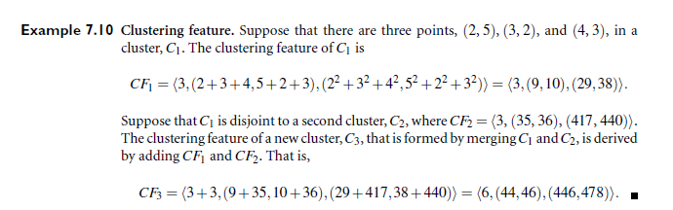

Slide 79
Clustering high-dimensional data
It is a particularly important task in cluster analysis because many applications require the analysis of objects containing a large number of features or dimensions.
For example, text documents may contain thousands of terms or keywords as features, and DNA microarray data may provide information
on the expression levels of thousands of genes under hundreds of conditions.

Slide 80
Clustering high-dimensional data
Clustering high-dimensional data is challenging due to the curse of dimensionality.
Many dimensions may not be relevant.
As the number of dimensions increases, the data become increasingly sparse so that the distance measurement between pairs of points become meaningless and the average density of points anywhere in the data is likely to be low.

Slide 81
Clustering high-dimensional data
CLIQUE and PROCLUS are two influential subspace clustering methods, which search for clusters in subspaces (or subsets of dimensions) of the data, rather than over the entire data space.
Frequent pattern–based clustering, another clustering methodology, extracts distinct frequent patterns among subsets of dimensions that occur frequently.

